Slide 1
SECURITY INCIDENT RESPONSE PLATFORM (TheHive)
FINAL REPORT
Lecturer: Nguyễn Duy
Group: 3
Subject: Advanced Network Security

Slide 2

OUR GROUP
20521978
Bạch Văn Xuân Thông
20521862
Trần Tấn Tài
20521841
Ngô Trần Thái Sơn
20522016
Phạm Bá Tín

Slide 3
CONTENTS
1
3
2
4
Incident Response Platform
Deployment
TheHive
Demo

Slide 4
1
Incident Response Platform

Slide 5
Incident Response Platform
What is incident response
Incident response (sometimes called security incident response) refers to an organization’s processes and technologies for detecting and responding to cyberthreats, security breaches or cyberattacks
Goal: prevent cyberattacks before they happen, and to minimize the cost and business disruption resulting from any cyberattacks that occur

Slide 6
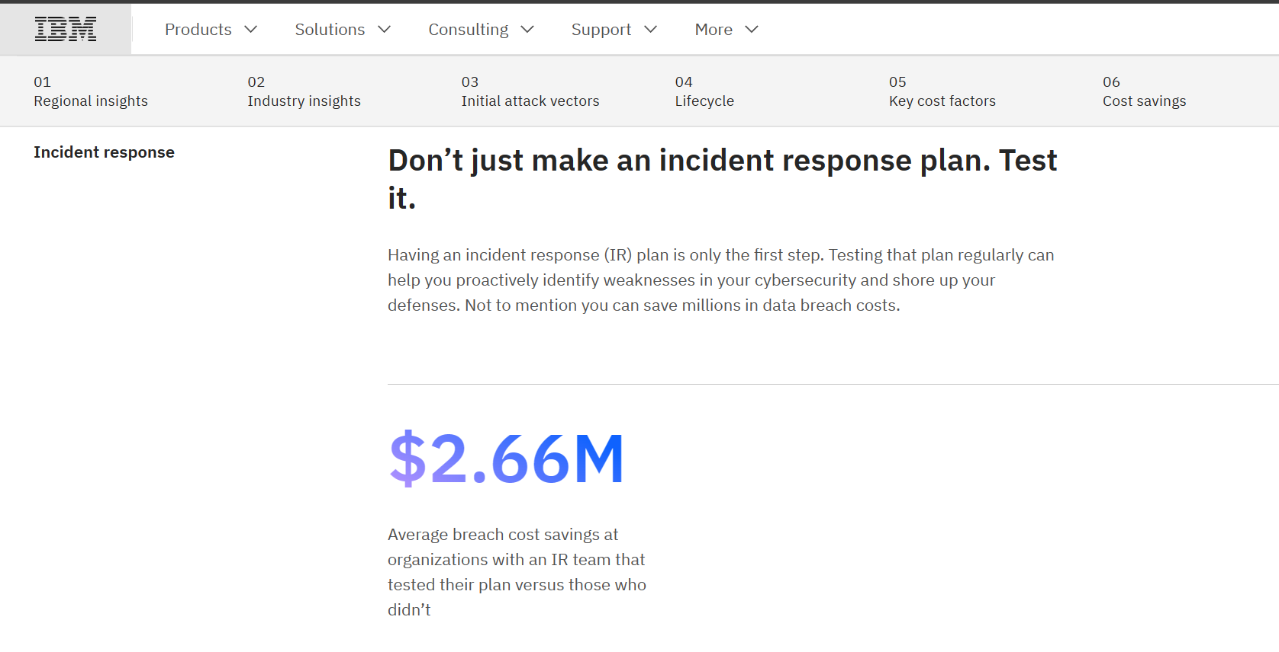
Incident Response Platform
If you have an effective incident response plan, you will:
- Detect and contain cyberthreats faster
- Restore affected systems clearly
- Reduce the lost revenue and other costs
Notes:
Một kế hoạch ứng phó sự cố hiệu quả có thể giúp các nhóm an ninh mạng phát hiện và ngăn chặn các mối đe dọa trên mạng, đồng thời khôi phục các hệ thống bị ảnh hưởng nhanh hơn, đồng thời giảm doanh thu bị mất, tiền phạt theo quy định và các chi phí khác liên quan đến các mối đe dọa này. Báo cáo Chi phí Vi phạm Dữ liệu năm 2022 của IBM cho thấy các tổ chức có nhóm ứng phó sự cố và các kế hoạch ứng phó sự cố được kiểm tra thường xuyên có chi phí vi phạm dữ liệu trung bình thấp hơn 2,66 triệu USD so với các tổ chức không có nhóm ứng phó sự cố và IRP.

Slide 7
2
TheHive

Slide 8
What is
TheHive is a scalable Security Incident Response Platform, tightly integrated with MISP (Malware Information Sharing Platform), designed to make life easier for SOCs, CSIRTs, CERTs and any information security practitioner dealing with security incidents that need to be investigated and acted upon swiftly

Slide 9
What for
Incident response collboration between security analysts
Easy exchange of incident infomation in through live streams
Case management, task follow-up and observables
Import cases for events from SIEM and other sources
Integration with MISP to share events and IOCs

Slide 10
Feature
Alert management
Case management
Multi Tenant Environments
Advanced User management
Notifications Framework
Metrics and dashboards
Comprehensive APIs
MITRE ATT&CK Integration
MISP Integration

Slide 11
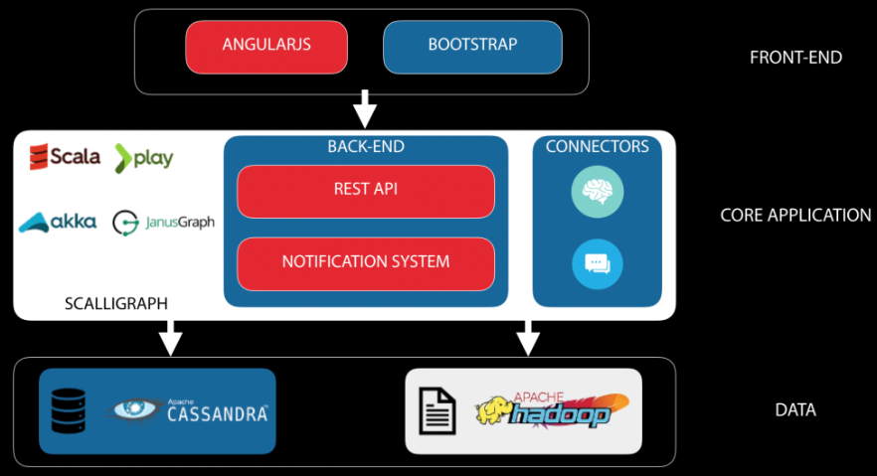
Architecture

Slide 12
3
Deployment

Slide 13
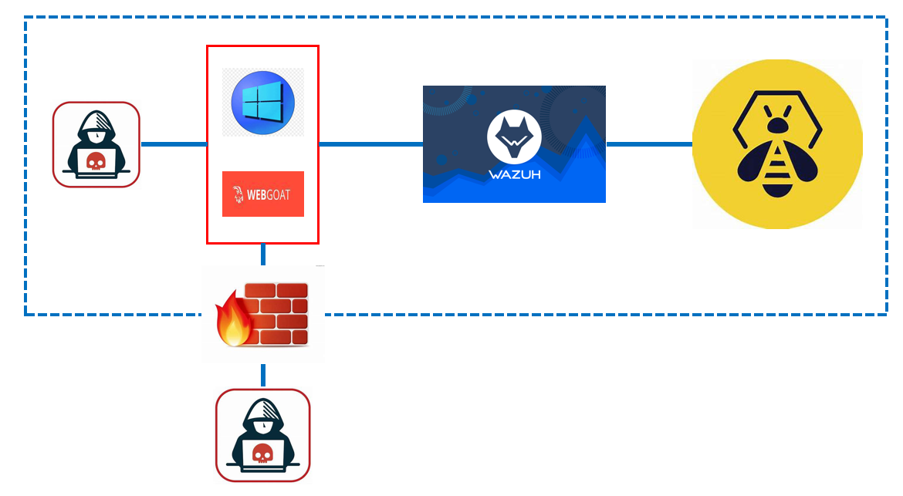
Topology

Slide 14
Topology
Host | IP | Service
Firewall | 192.168.3.1 192.168.111.142 (NAT) | IPtable
Wazuh | 192.168.3.10 | Wazuh-indexer Wazuh-server Wazuh-dashboard
TheHive | 192.168.3.11 | Cassandra Elasticsearch TheHive4
Ubuntu | 192.168.3.12 | WebGoat Wazuh-agent
Windows | 192.168.3.13 | Wazuh-agent
Kali (Attacker) | 192.168.3.14
Topology description table

Slide 15
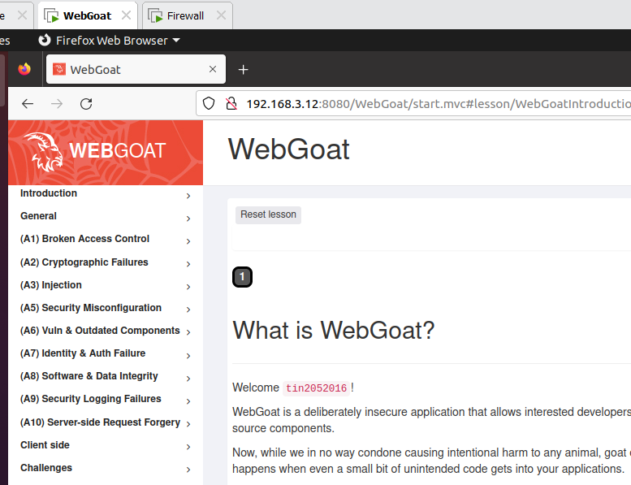
Installation
WebGoat

Slide 16
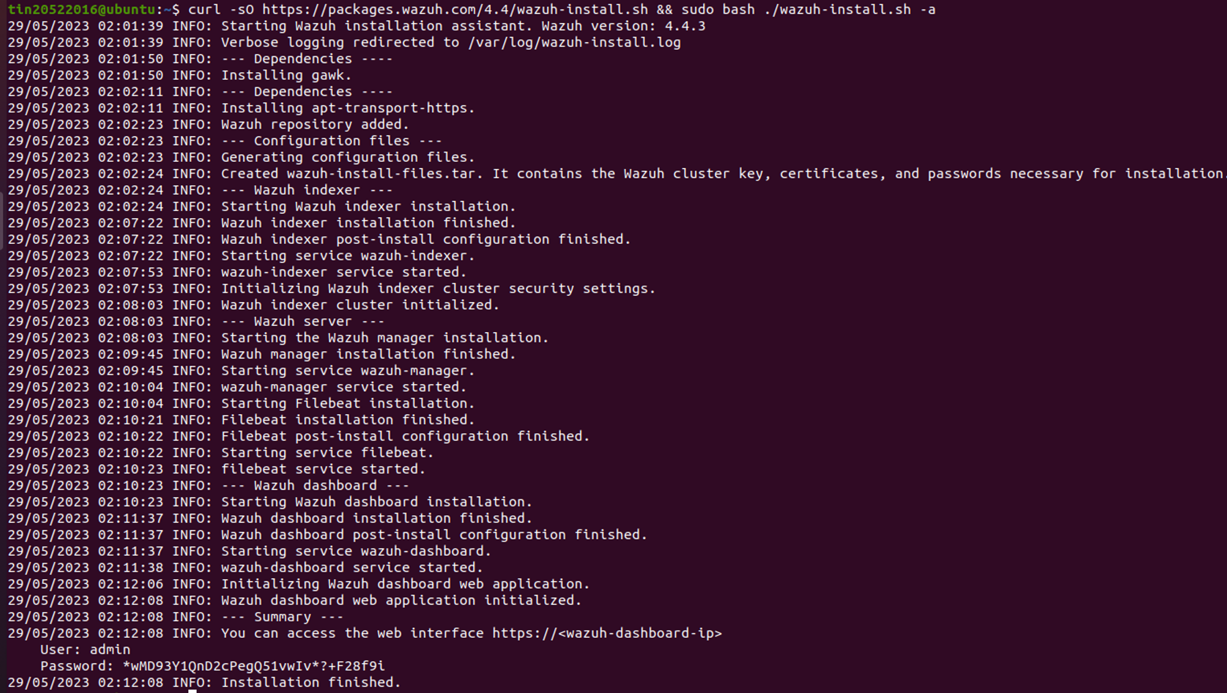
Installation
Wazuh

Slide 17
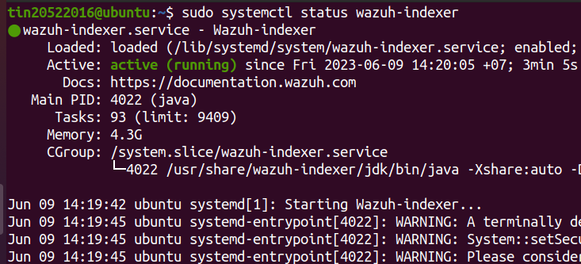
Installation
Wazuh
Wazuh indexer

Slide 18
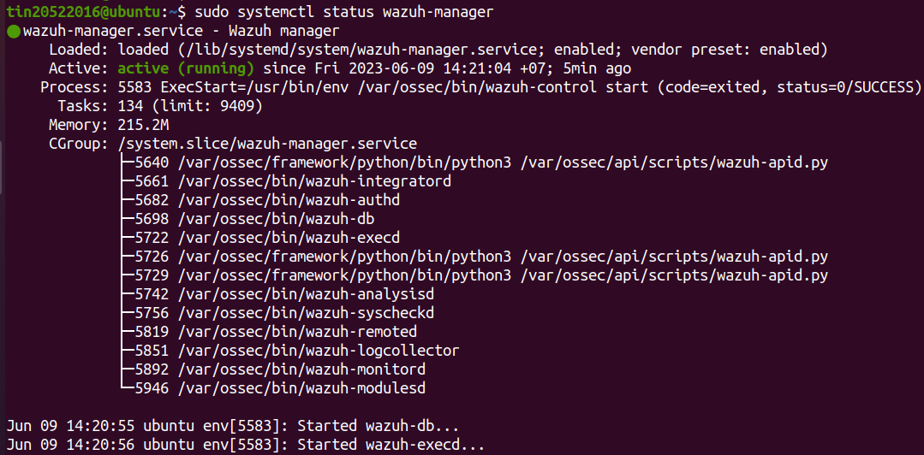
Installation
Wazuh
Wazuh manager

Slide 19
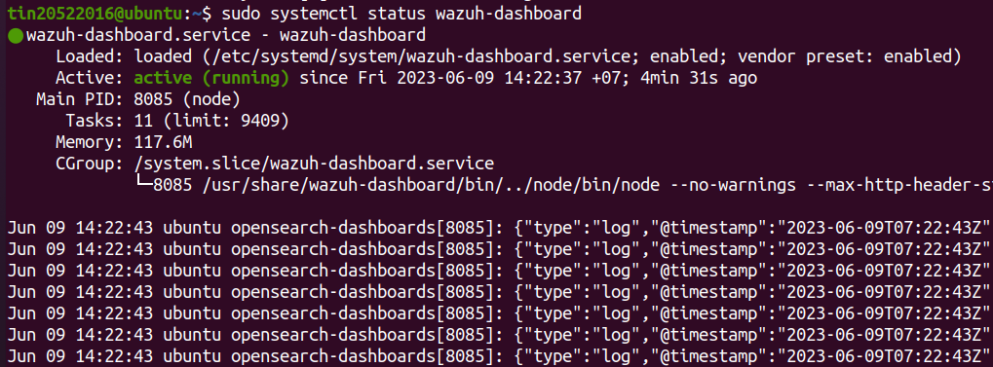
Installation
Wazuh
Wazuh dashboard

Slide 20
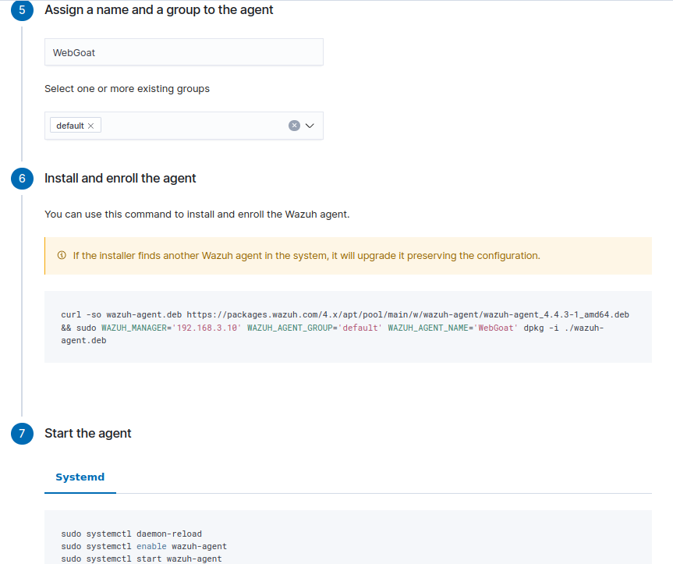
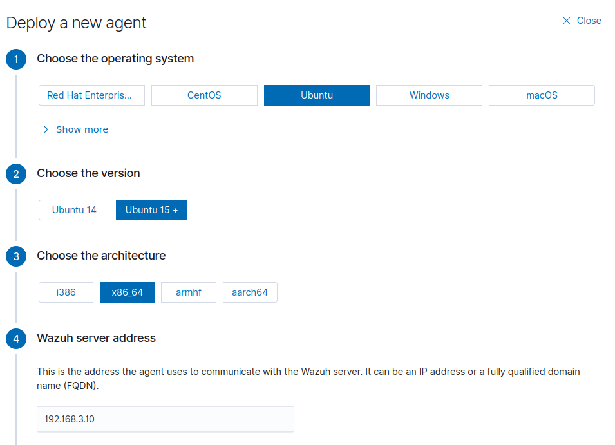
Installation
Wazuh Agent
Ubuntu

Slide 21
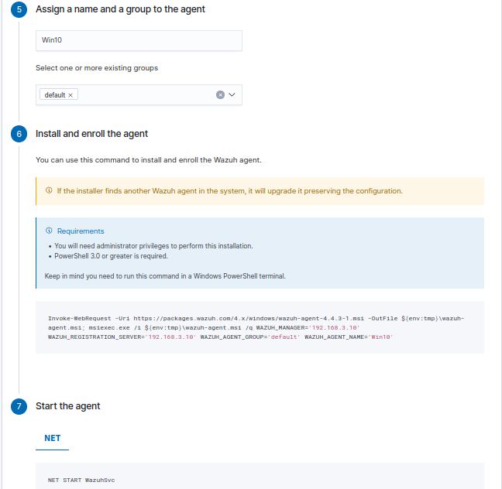
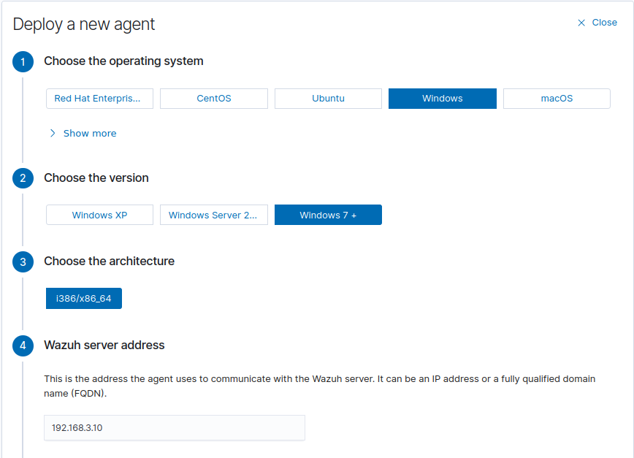
Installation
Wazuh Agent
Windows

Slide 22
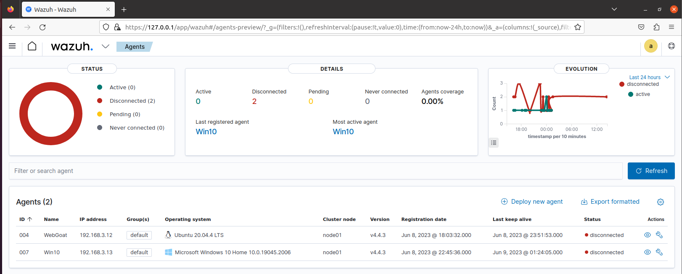
Installation
Wazuh
Wazuh web interface

Slide 23
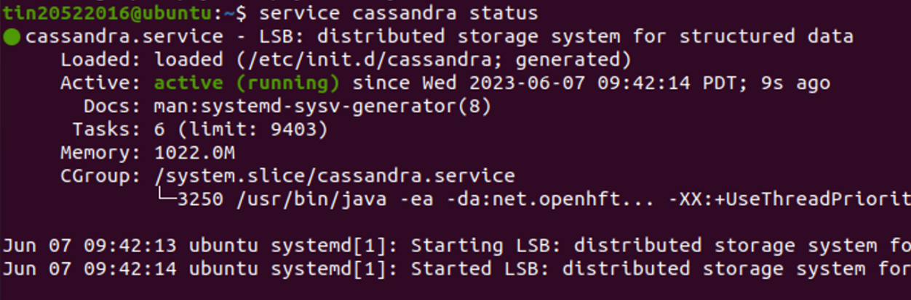
Installation
TheHive
Cassandra

Slide 24
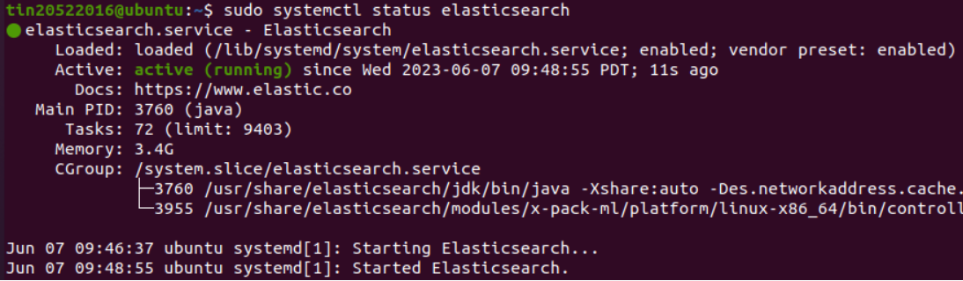
Installation
TheHive
Elasticsearch

Slide 25
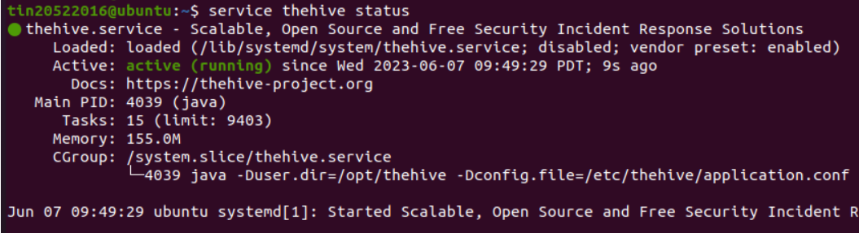
Installation
TheHive
TheHive4

Slide 26
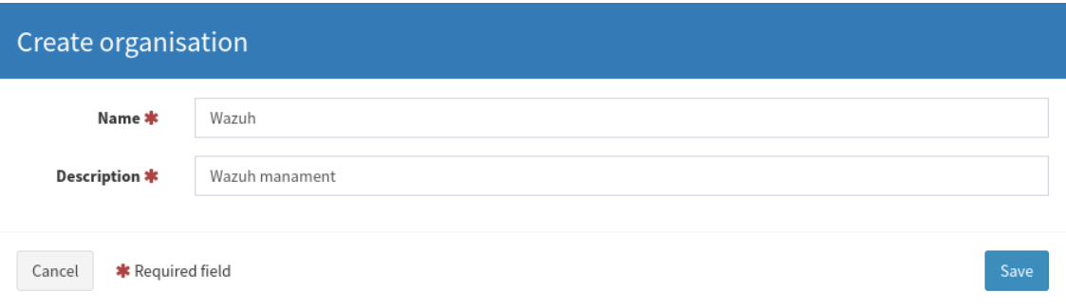
Installation
Wazuh + TheHive
Create Wazuh Organisation

Slide 27
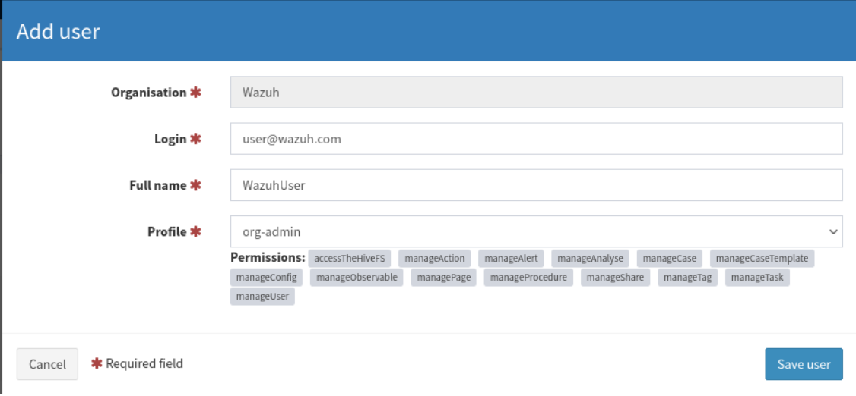
Installation
Wazuh + TheHive
Add user with administrator privileges

Slide 28
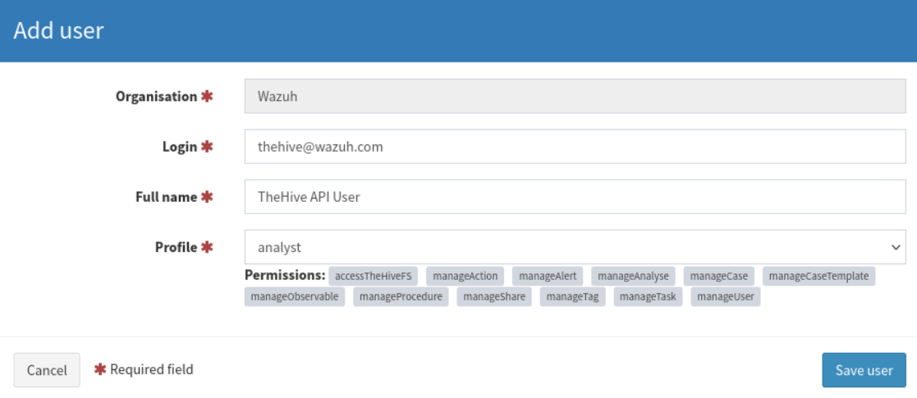
Installation
Wazuh + TheHive
Add user with “analyst” privileges

Slide 29
Installation
Wazuh + TheHive
Generate the API key

Slide 30
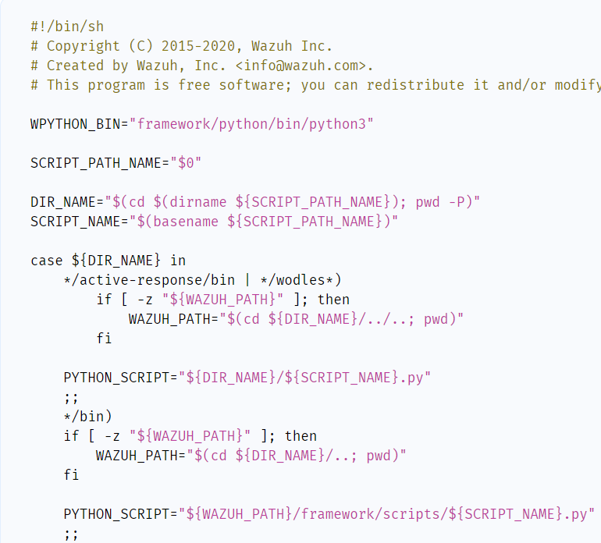
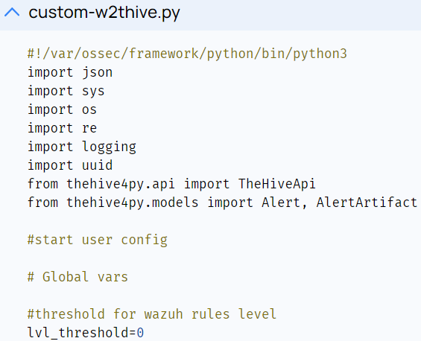
Installation
Wazuh + TheHive
Install TheHive Python module
Create the custom integration script in
/var/ossec/integrations/custom-w2thive.py
Create a bash script as
/var/ossec/integrations/custom-w2thive
Configure Wazuh manager

Slide 31
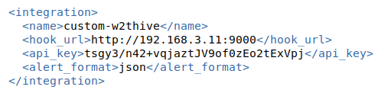
Installation
Wazuh + TheHive
Add the following lines to the manager configuration file located at /var/ossec/etc/ossec.conf
Restart the wazuh-manager
Configure Wazuh manager

Slide 32
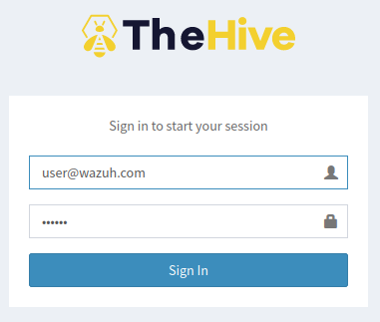
Installation
Wazuh + TheHive
TheHive4

Slide 33
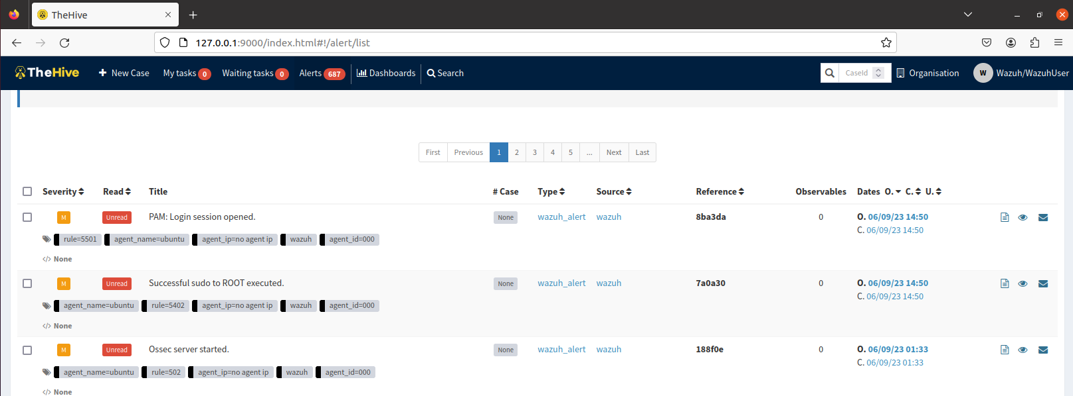
Installation
Wazuh + TheHive
TheHive4

Slide 34
4
Demo

Slide 35
Shellshock Attack
Link: https://drive.google.com/file/d/1zXfMww9yrJpUeUwZjGm2HDRFv9dIvAqi/view?fbclid=IwAR1cozEeuxohztfX1KXK5L4d2YQwikp8EM6O_qKMz3kNaW8i5gLvhOErloM

Slide 36
Detect Malware – CDB list
Link: https://drive.google.com/file/d/1d1QjpAr8ysWYmHBEqA6fiv3FQpe8mCfk/view?usp=sharing

Slide 37
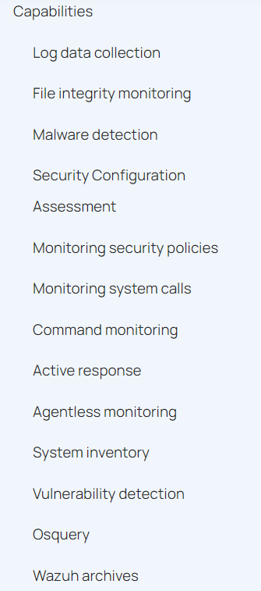
Future work
Attack WebGoat
Attack from external network
Other (reference:
https://documentation.wazuh.com/current/user-manual/index.html)
...

Slide 38
Thanks for listening!!

